Slide 1
IDEA-B Funding Public Meeting
Rootstown Local School District
April 17, 2023
Rootstown High School Cafeteria
Notes:
‹#›

Slide 2
Purpose of IDEA-B Funding:
To provide supplemental federal funds to assist in the costs of providing special education and related services to children with disabilities.
a. Funds under this program are combined with state and local funds to provide a Free Appropriate Public Education to children with disabilities.
b. IDEA-B grant funds that flow-through to the LEAs may be used for staffing, educational materials, equipment, and other costs to provide special education and related services, as well as supplementary aids and services, to children with disabilities.
Notes:
‹#›
L

Slide 3
c. Funds are allocated among states in accordance with the statutory formula in Sec. 611 of the Individuals with Disabilities Education Act (IDEA). Each state is allocated an amount equal to the amount that it received for FY 1999.
d. More information available at:
http://idea.ed.gov
Notes:
L
‹#›

Slide 4
2022-2023 School Year
Disability Categories – 178 Total
Autism – 17 (9.3%)
Deaf-Blindness – 0 (0%)
Developmental Disability – 4 (2.2%)
Emotional Disturbance – 9 (5.0%)
Multiple Disabilities – 2 (1.1%)
Hearing Impairment – 2 (1.1%)
Intellectual Disability – 7 (3.8%)
Orthopedically Impairment - 1 (.5%)
Other Health Impairment (Minor) – 31 (16.9%)
Specific Learning Disability – 84 (45.9%)
Speech & Language Impaired – 26 (14.2%) As a related service - 49
Tramatic Brain Injury – 0 (0%)
Visual Impairment (Inc. Blindness) – 0 (0%)
Twice Exceptional - 0 (0%)
Notes:
Rootstown 15%, statewide 16%, similar districts 13%

Slide 5
2023 Rootstown Employs/Contracts:
1 Special Services Director
1 School Psychologist
1 Secretary (6 hours/day)
12 Intervention Specialists
12 Educational Aides + 1 Substitute Aide
1 Preschool Interventionist/General Ed Teacher
2 Educational Aides - Preschool
1.5 Speech-Language Pathologists (.5 does Presch/MS/HS/MW/EA)
1 Audiologist (~3-5 days per year)
1 Occupational Therapist (4 days/wk for Presch/District/MW/EA/LEAP)
1 Physical Therapist (1 day/wk for District/EA)
1 RN + 2 LPN’s
3 School Counselors
1 Behaviorist (6-7 days per year)
Notes:
Serve students as young as 3 and as old as 22
‹#›

Slide 6
Six Principles of IDEA
Principle of IDEA | Requirements
Zero Reject | Locate, identify & provide services to all eligible students with disabilities
Protection in Evaluation | Conduct an assessment to determine if a student has an IDEA related disability and if he/she needs special education services
Free Appropriate Public Education | Develop and deliver and individualized education program of special education services that confers meaningful educational benefit
Least Restrictive Environment | Educate students with disabilities with non disabled students to the maximum extent appropriate.
Procedural Safeguards | Comply with the procedural requirements of the IDEA regulations
Parental Participation | Collaborate with parents in the development and delivery of their child’s special education programs

Slide 7
Principle 1:
Zero Reject
Locate, identify & serve all students with disabilities ages 3 through 21
Child find obligations
Two criteria for eligibility:
A student must be determined to have a disability that is covered by the IDEA
Because of the disability, the student needs special education and related services
Notes:
Must not only serve but locate and identify

Slide 8
Principle 2:
Protection in Evaluation
LEA’s shall conduct a full and individual evaluation before the initial provision of special education and related services to a child with a disability
Notes:
Each child entitled to a full individual evaluation

Slide 9
Evaluation Procedures
A student must be assessed in all areas related to the suspected disability
The school is required to use a variety of assessment tools and strategies to collect functional and developmental information that may assist in determining:
Whether a student has a disability
The educational needs of a student
Specially designed instruction

Slide 10
Principle 3:
Free Appropriate Public Education (FAPE)
Special education and related services
Provided at public expense
Meet state educational agency standards
Provided in conformity with the Individualized Education Program (IEP)
Notes:
FAPE - Special education must meet standards and the IEP

Slide 11
Special Education is:
Specially designed instruction to meet the unique needs of a student with disability
Instruction must be made available within a continuum of placements: i.e. classroom, home, hospital
Includes academic skills, physical and motor skills, language skills, vocational skills, and functional skills
Notes:
Special education defined by law

Slide 12
Non-Exhaustive List of Specific Related Services
Assistive Technology
Counseling and Psychological Services
Residential Placement
Social Work Services
Parent Counseling and Training
’
Speech Therapy
Transportation
Physical and Occupation Therapy
Interpreters
School Health Services (excluding complex health services if needed)
Surgically implanted medical devices (e.g. Cochlear Implants)
Medical Services

Slide 13
Principle 4:
Least Restrictive Environment (LRE)
To the maximum extent appropriate children with disabilities are to be educated with children who are not disabled
Removal may only occur when education regular classes with the use of supplementary aids and services cannot be achieved satisfactorily

Slide 14
Continuum of Placements from Least to Most Restrictive
Monitoring
In-Class Support
Consultation
Co-Teaching
Special Education Pull-Out
Self-Contained
Separate Facility/Home Instruction
Residential Placement

Slide 15
Principle 5:
Procedural Safeguards
Notice and consent requirements
Surrogate parents
Opportunity to examine records
Independent educational evaluation
Discipline
Mediation
Resolution Session
Impartial due process hearing
Notes:
Comply with federal IDEA regulations

Slide 16
Principle 6:
Parental Participation
Parental Notification and Consent
Purpose: to provide parents with sufficient information, in a timely manner, so that they may fully participate in educational decisions
Written notice and consent

Slide 17
Special Education Process
Programming
Evaluation
Develop the IEP
Deliver services
Monitor progress
Reevaluation
Assessment
Determine Eligibility
Determine Programming
Notes:
1 assess 2 iep and deliver services 3 monitor and re evaluate

Slide 18
Amount Spent
Special Education
Prior Year (2022)
State and Local Funds | $2,180,495
Federal Funds | $ 241,682
Total | $2,422,177
Notes:
‹#›

Slide 19
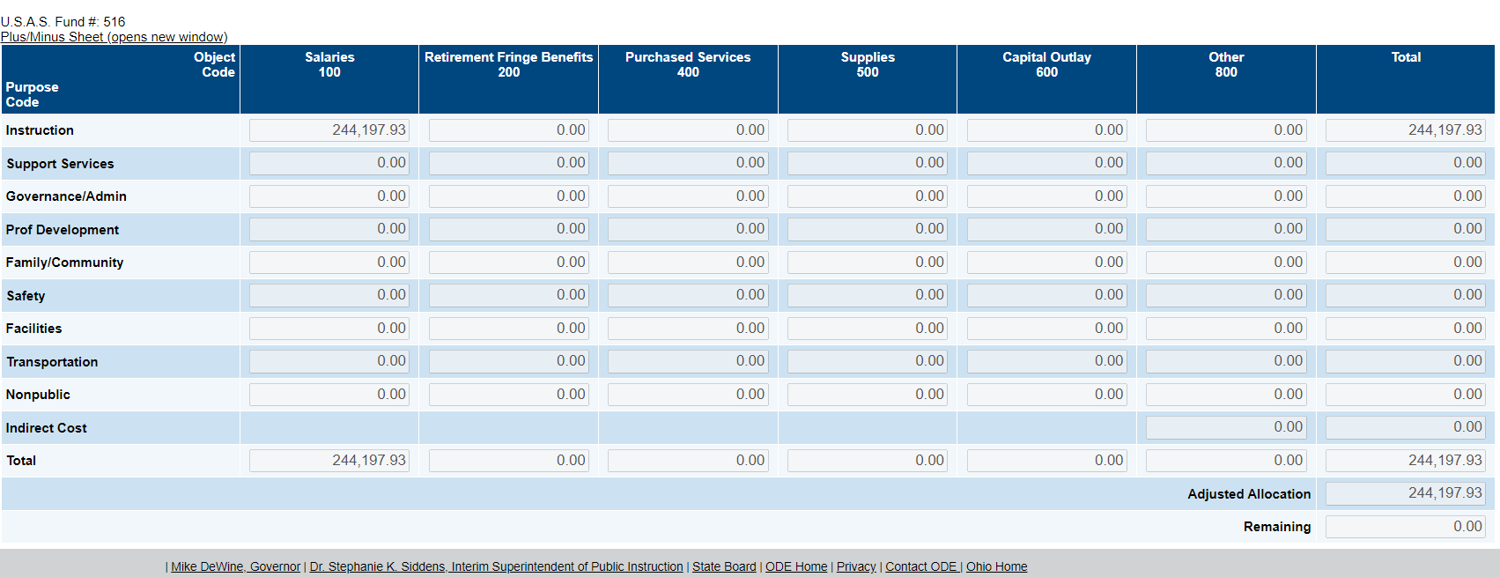
IDEA Federal Budget
2022-2023
Notes:
‹#›
C

Slide 20
IDEA-B funds are used for salaries for:
3 Intervention Specialists
1 Alternative Program Specialist
.5 Educational Aides
Notes:
‹#›
C

Slide 21
Please give us your thoughts/ideas on other ways that the funds can be allocated for the 2023-2024 school year.
Notes:
‹#›
L

Slide 22
For more information, please contact:
Connie Baldwin
Treasurer
330-325-9911
Thank you!
Notes:
‹#›

